Slide 1
Keurig and Wrap-up
Pricing Strategies
2024
Jean-Pierre Dubé
© Copyright 2024

Slide 2
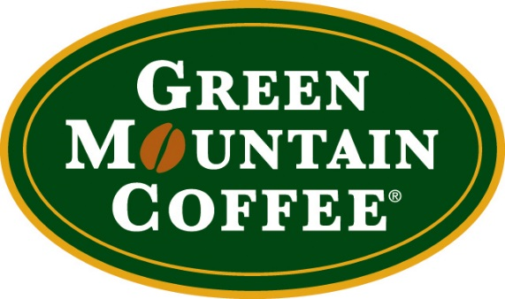
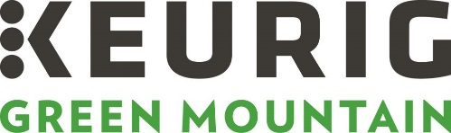
Keurig since the case GMCR’s rise & transformation
acquisitions
Keurig (2006)
Van Houtte (2010)
Diedrich (2009)
2010: GMCR sold 2.9 billion Keurig-cups (75% CAGR)
May 2013: GMCR Q2 profits up 42%
March 2014: changed name to Keurig Green Mountain
Notes:
Starbucks launched espresso maker in 2012, but re-signed a long-term contract with GMCR in May 2013.

Slide 3
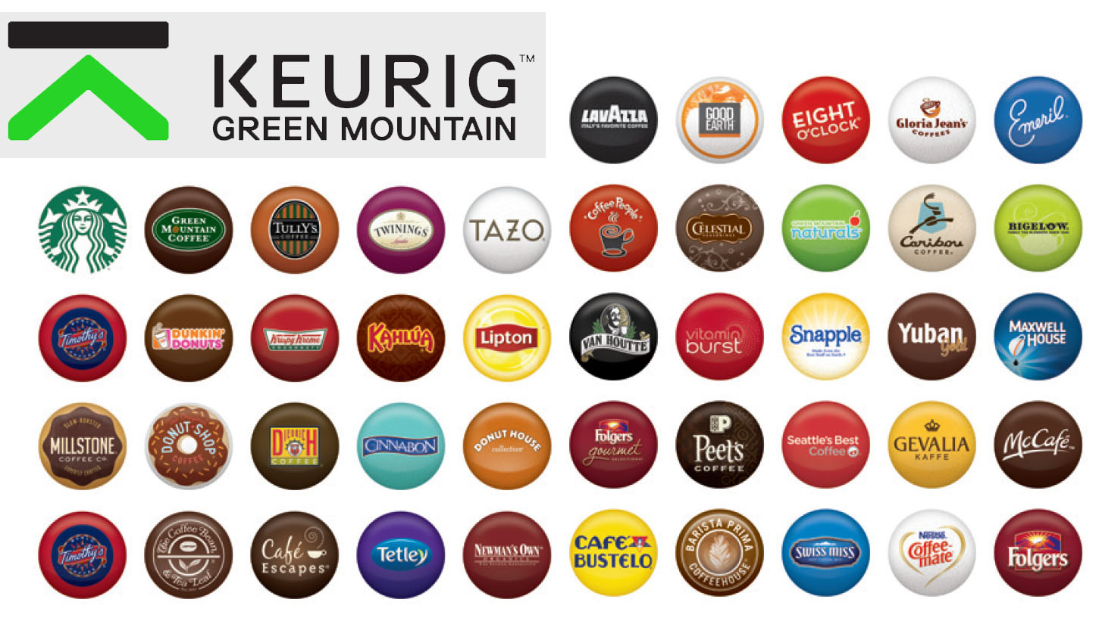
Partnerships to secure dominance

Slide 4
Keurig Today
According to the National Coffee Association (2016):
28% penetration of US households (42% as of 2021)
32.09% of US sales of ground & whole bean coffee
2020 net sales $4.43 billion → $3.6 bill from pods
23% of coffee-pod business
(recall case sized market at $3 billion in 2002)
Challenges
Company predominantly selling k-cups now

Slide 5
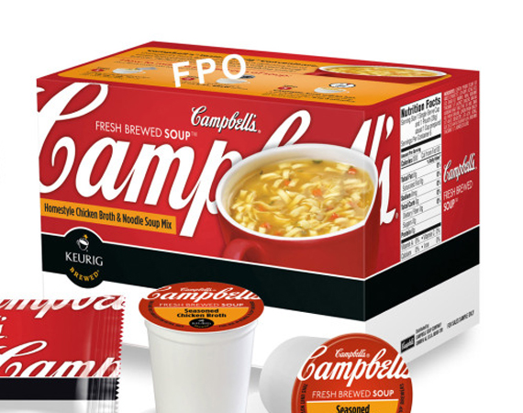
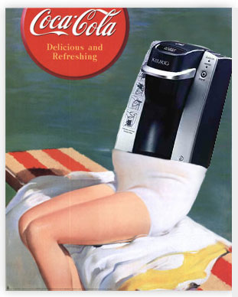
Challenges Diversification
Maker of Coffee Pods Adds New Flavor: Soup
Green Mountain, Campbell to Introduce Packets for Broth
WSJ, 9-4-2013
Coca-Cola takes on Soda Stream in home soda machine war
LA Times, 2-6-2014
How Coke's new Keurig machine stacks up to Sodastream: http://finance.yahoo.com/news/here-s-what-the-new-coke-keurig-soda-machine-will-cost-you-225303377.html
Coke Closes On $1.25 Billion Green Mountain Stake [10% stake]
Vending Times, 3-3-2014
Coke Plans to Increase Keurig Stake to 16% [another $billion]
WSJ, 5-14-2014

Slide 6
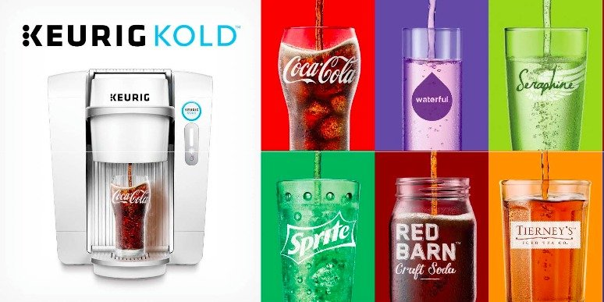
Challenges Diversification
“The Keurig Kold: You could just buy a mini-fridge instead”
Kris Naudus, engadget, 11-07-2015
Notes:
Price = $299.99

Slide 7
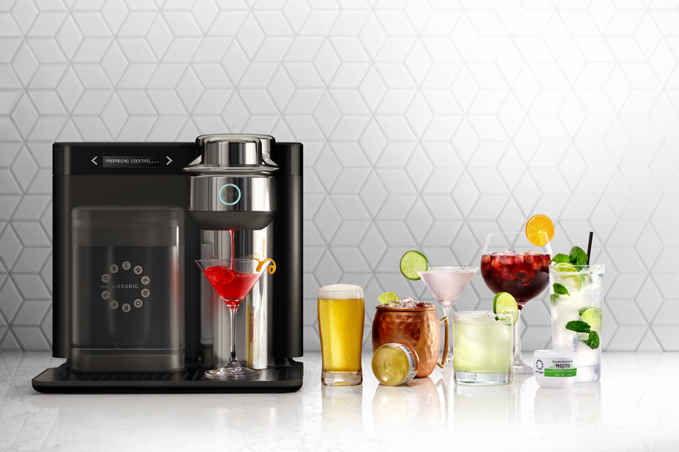
Challenges Diversification (growth desperation?)
Keurig’s New Drinkworks Home Bar Is Perfect for the G&T Lover Who Can’t Be Bothered to Mix Gin With Tonic
Rachelle Hampton, Slate.com, Nov 15 2018
Why Keurig’s $300 Cocktail Machine Failed
Feb 7, 2022
Released broadly in Jan 2020 for $299
Pods: $2.50-$3.50 each
Mixes liquid in pod with water
26 mins to chill water
For the low price of $299, you can make exotic drinks like a Gin and Tonic or a Vodka Soda at home!
Notes:
Price = $299.99

Slide 8
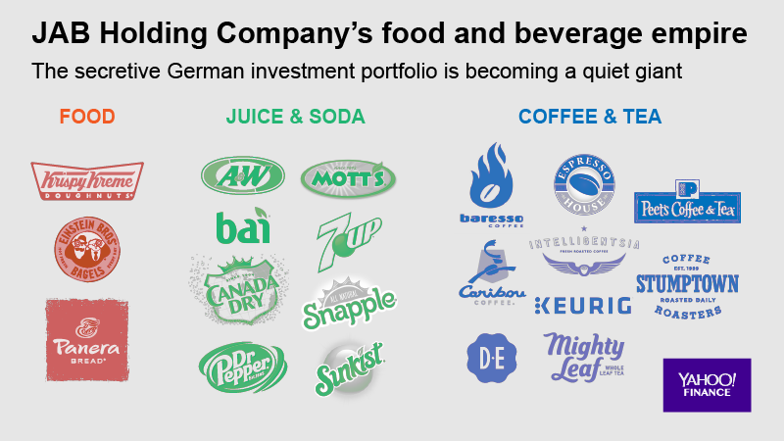
JAB Acquisition
“Keurig to Go Private in $13.9 Billion Buyout Led by JAB”
By Jennifer Kaplan, Bloomberg,12-7-2015
JAB: German holding company in foods including coffee:
Jacobs Douwe Egberts (largest pure-play CPG coffee)
Pete’s Coffee
Caribou Coffee
Espresso House (largest chain in Scandinavia)
Baresso Coffee (largest chain in Denmark)

Slide 9

Keurig Acquires Dr. Pepper-Snapple
“Keurig to Acquire Dr Pepper Snapple in Largest Soft-Drink Deal Ever”
WSJ,1-29-2018
$19 billion deal
“Keurig coffee systems gain 3 million new users”
FoodBusinessNews, 3-1-2021
Installed base grew from 21 mill to 33 mill since merger!
Record number of upgrades
(recall case sized market at 20 million in 2002)

Slide 10
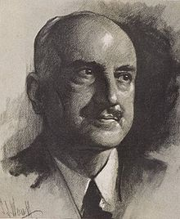

Challenges: Marketing For Good? Patent Expiration in 2012
“Consumer Storm Brewing Over Keurig 2.0”
The Ledger, 5-1- 2015
Message if insert reusable coffee pod in Keurig 2.0:
‘‘Oops! This pack wasn't designed for this brewer. Please try one of the hundreds of packs with the Keurig logo.”
Keurig’s explanation:
Authentic K-cup so brewer would “know the optimal settings for the inserted Keurig pack, for a perfect beverage every time.”
“Keurig K-Cup Class Action Settlement”
Top Class Actions, 1-14-2021
$31 million settlement
Those who cannot remember the past are condemned to repeat it.
George Santayana

Slide 11
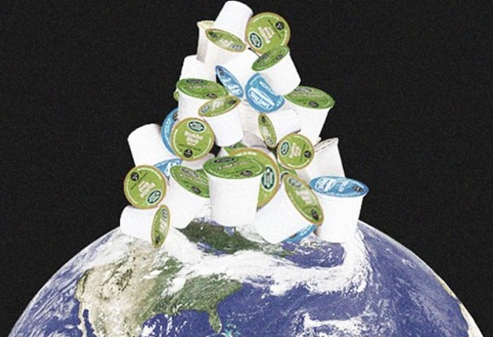
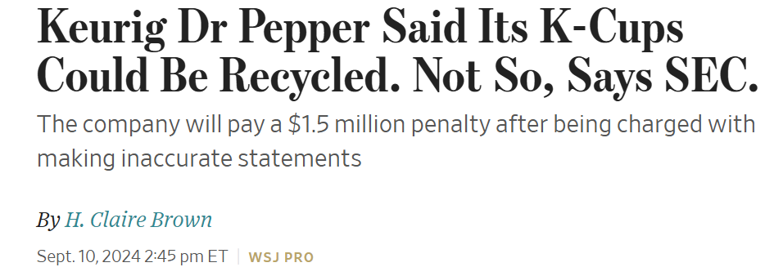
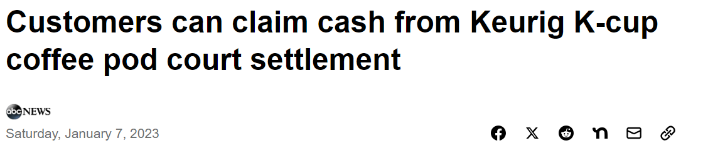
Challenges: Marketing For Good Corporate Social Responsibility
Sour Brew: How Keurig Cofounder Came to Hate His Invention, The K-Cup
Daily Tech, 3-5-2015
What do you do with all the discarded K-cups?
According to Vice:
“Keurig brewer generates 10 times the solid waste … from a standard drip brewer.”
“In 2014, …there were enough discarded K-Cups to circle the earth 10.5 times.”
vice.com, 2-13-2016
Keurig Class Action Settled For $10M, Ending Recyclability Claims
TopClassActions.com, 3-3-2022
(Smith v. Keurig Green Mountain Inc., Case No. 4:18-cv-06690, in the U.S. District Court for the Northern District of California.)
Also requires disclaimer that pods are not recyclable
On labels
On website

Slide 12
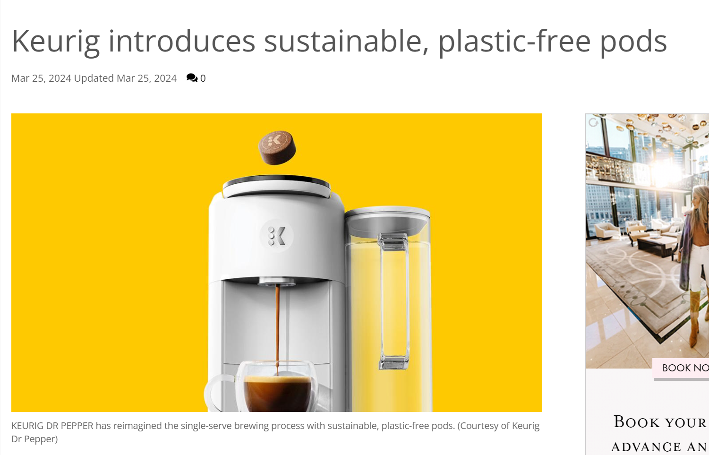
Challenges: Marketing For Good Corporate Social Responsibility
"expertly roasted coffee beans that are ground, pressed and wrapped in a proprietary, protective plant-based coating preserving the coffee's flavor and aroma, eliminating the need for plastic or aluminum.”

Slide 13

Course Wrap-up

Slide 14
Peer Evaluation
Each of you will receive an individual e-mail from TA
Group number
Password
Link to online peer eval survey

Slide 15
Final Project
Available on Canvas:
Based on lecture/HW material
Due online no later than
Electronic submission (see assignment for instructions)
After class today
AXP: 11:59pm (Central Time) Sunday, Jul 27, 2025
XP: 11:59pm (Central Time) Sunday, Aug 3, 2025

Slide 16
Pricing Summary
Customers don’t purchase based price, but on value in exchange for price
Optimal pricing balances value, costs and competition
Need the right data and systems in place
Demand measurement is often an obstacle
Only use relevant (incremental) costs for pricing
Managing pricing for a product line requires coordination
Substitutes: manage cannibalization (“trading down”)
Complements: loss-leading as an investment
Unprofitable discounts today can be investments in CLV
See Course Summary Appendix at end of deck

Slide 17

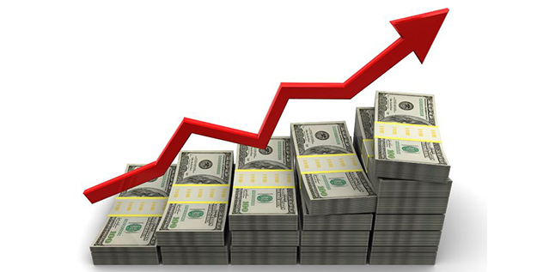
Good luck!!!!
With Finals …
With applying pricing tools in your new jobs ….

Slide 18
Appendix: Course Summary

Slide 19
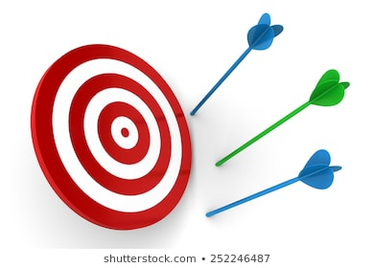
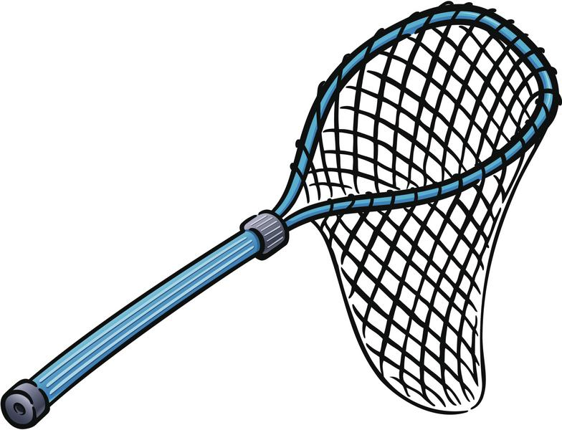
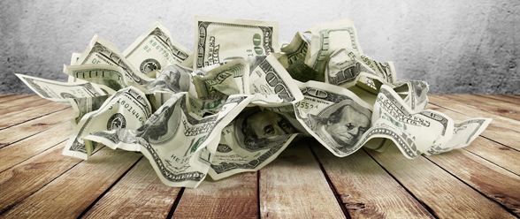
Heuristic pricing leaves money on the table
Cost-plus
Match competitor
Complex pricing as a “me-too” gimmick
Uncoordinated product line prices
Monetization

Slide 20
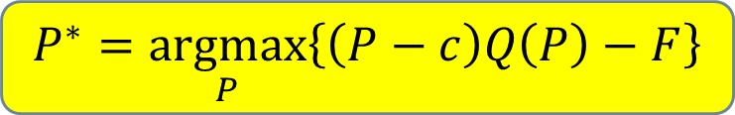
Monetization Framework I Optimization
$$P^{∗}=\underset{P}{argmax}\left\{\left(P−c\right)Q\left(P\right)−F\right\}$$
(Modules 1-5)
Costs
Typically unavoidable and irrelevant to pricing decisions
Costs
Incremental/marginal costs
Value
Demand & WTP
Competition
Demand & Reference Product
Comments
Determine your objective and optimize it
e.g.,
Profit objective - measurements of demand & marginal cost
NPV of profits objective -- also trial & repeat demand
(Module 9)

Slide 21
Monetization Framework I Optimization Toolkit
Demand measurement
Qualitative (e.g., focus groups, customer journey maps)
EVC
Randomized Price Experiments
Regression
Conjoint Analysis
LTV analysis
Costing
Marginal cost & contribution (not fixed/average cost & gross)
Competition
Anticipate potential competitive reactions
Strategic thinking (game theory)
(not covered)
(module 1)
(module 2)
(extra slides)
(module 9)
(module 4)
(module 5)

Slide 22
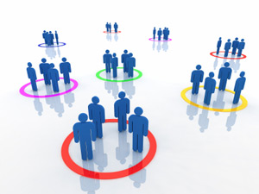
Monetization Framework II Pricing Structures
Price
(low)
Product 3
Best
Price
(high)
Product 1
Good
Product 2
Better
Price
(medium)
Comments
Use microeconomics to design pricing structures that capture customer value (Price Discriminate)
Examples:
Targeted pricing (fences)
Versioning (quality fences)
Nonlinear pricing (quantity fences)
Mixed Bundling (system vs components)
Razors & Blades/Metering (complementary goods)
(modules 6-8)

Slide 23
Monetization Framework II Pricing Structure Toolkit
Sustainability of the fences
Perceptions of fairness
Preventing Arbitrage
Managing Cannibalization
(modules 6-8)

Slide 24
Price Management
Coordination of 4 Ps
Price and perceived Product value
Promoting a Price premium (you need to market the price)
Product Line Prices
Price and Place (downstream firm in channel)
Coordination within the firm
Contribution margins vs Gross Margins (finance & Pricing)
Product Line Prices across brand management teams (HR and incentives)
(extra slides)

